Slide 1

increasing price of energy and its effect on different Households
By Haidar Ali

Slide 2
MY RESEARCH QUESTIONs
How has the rising cost of energy impacted households in the UK?
How does the rising energy prices affect both higher and lower income families?
Do to this, I will use a variety of data sources, and combine them.

Slide 3
Introduction
Good morning. Today, I'm going to talk about the increasing price of energy and its effect on different economic sectors in the UK.
The price of energy has been rising steadily in recent years. This is due to a number of factors, including:
The increasing demand for energy from developing countries
The depletion of fossil fuels
The increasing cost of renewable energy
Ukraine-Russia war

Slide 4
Energy Effect on CPI
The rising cost of energy has had a significant impact on the Consumer Price Index (CPI). The CPI is a measure of the prices of goods and services in the UK. When the price of energy goes up, it pushes up the CPI, which means that people have less money to spend on other things.
In 2022, The CPI in the UK was 9.1% (10.1% jan 2023, 10.4% feb 2023). Energy prices in 2022 rose 28.7%, which is a major reason that the CPI rose very highly in 2022.
The high inflation rate in the UK is causing a squeeze on household incomes. People are having to pay more for the things they need, and this is having a negative impact on their spending power.

Slide 5
Data VALIDATION & cleansing (in excel)
The data used in this presentation is the given in the linked article. This data contains 3 columns, which are “COICOP Class level item”, “Energy Intensity” & “Energy Intensity Group”. Please note, I converted the xslx file to a csv file.
“COICOP Class level item” column contains a sequence of numbers and item name. Some of these contain a sublevel (e,g: 01.1.1), whereas some do not contain an extra value at the end. Values without a sublevel are filled in manually so all values have the same format. No missing values are here.
“Energy Intensity” column values are all valid in a percentage number format. No missing values are here.
“Energy Intensity Group” column values contain 6 unique values (Very low, low, high, very high, energy, and rents. No missing values are here.

Slide 6
Data cleansing (in Python)
Using pandas, I converted the csv file to a pandas DataFrame. I first split the “COICOP Class level item” column into 4 columns called class, level, sublevel and item name.
The “class” column can interpreted better than numbers, so using the category list in Table 1 from the article, I can appropriately name each class with a string rather than a number.
We can change the “Energy Intensity” Column to numeric by removing the %. I also converted the “level” and “sublevel” to numeric.

Slide 7
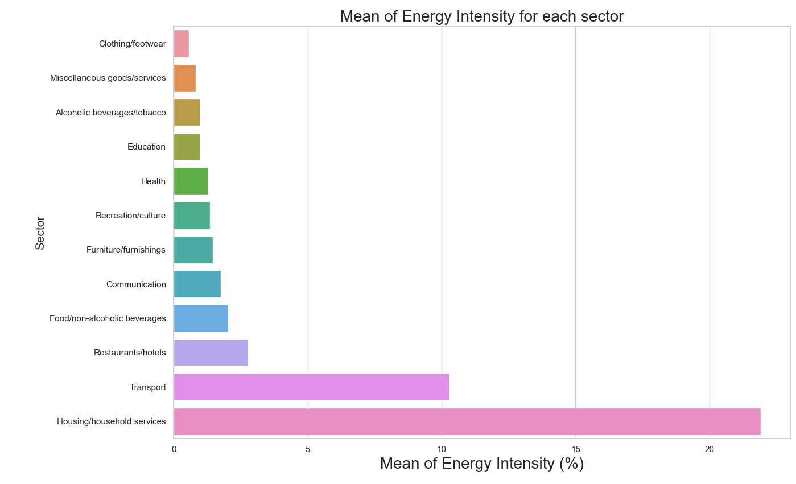
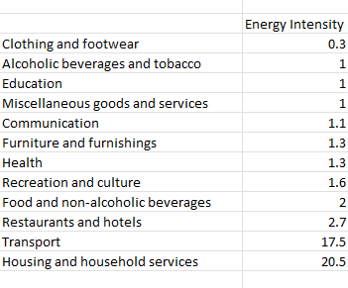
The effect of energy on each sector
Note: matplotlib and seaborn are used to generate this plot on python.

Slide 8
Effects on a specific Services
Energy intensity is highest for housing and household services (20.5%) - which includes gas, electricity, and liquid fuels - and transport (17.5%), which includes fuels and lubricants. These energy components have indirect energy intensity rates of 58% (gas), 57% (electricity), 69% (liquid fuels) and 68% (fuels and lubricants) and reflect around four-fifths of the total energy expenditure of the CPI basket. In contrast, energy intensity is lowest for insurance (0.2%).
Restaurants and hotels have an energy intensity of 2.7%. Accommodation services (3.1%) is more energy intensive than catering services (2.6%), although there is more spending on catering services. The minimum energy usage needed to be able to provide these services, regardless of the number of customers, likely accounts for their high energy intensity.
In contrast, clothing and footwear have an energy intensity of 0.3%. Its production process is more dependent on non-energy inputs, such as labour.

Slide 9
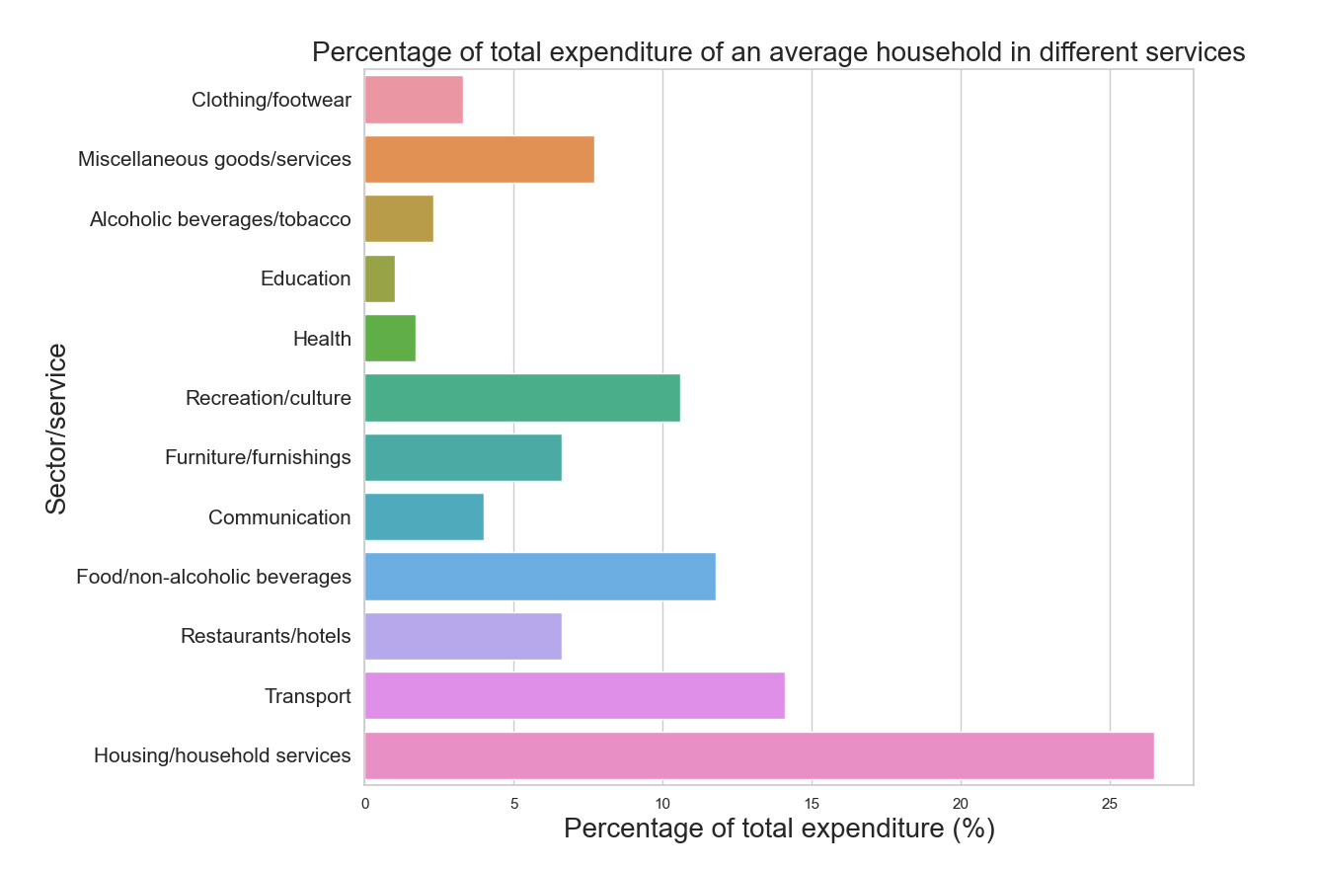
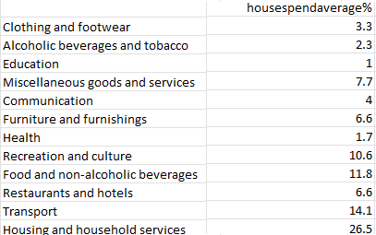
Average household expenditure for each Service/Sector
Data obtained from gov website “Family spending workbook 1: detailed expenditure and trends”.

Slide 10
How much does energy prices affect an average household’s expenditure?
The average household expenditure for each service can be multiplied by the Energy Intensity of each service to give us the value of how energy affects what we spend. From doing this calculation gives that roughly 8.8% of our household expenditure is affected by energy intensity. This is a rough calculation as I took averages of expenditure and energy expenditure of each service.
Next, I will look at households with different incomes. I look at both extremes and the average. The high earning households are the top tenth percentile, and the low earning households are the second tenth percentile . I do not choose to do the bottom tenth percentile as some data is missing and income varies a lot.

Slide 11
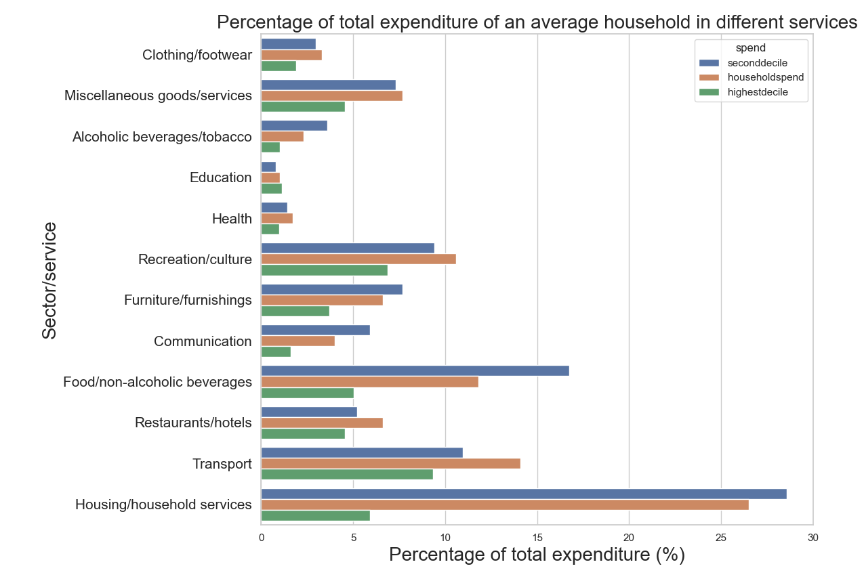
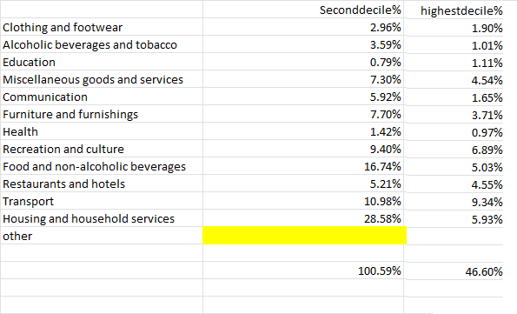
Percentage of expenditure for different households (clustered bar chart)

Slide 12
How much does energy prices affect extreme household’s expenditure?
Second decile – 8.78%
Average – 8.76%
Highest decile – 3.33%

Slide 13
Recommendations and improvements
Data suggest they is a clear divide on how energy prices affects low and high income.
Improvements:
Go into depth and use deeper information, like categories for each service (e.g. bread for food) to get a better calculation on energy intensity for different incomes.
Look at different regions as they might have different prices and different spend.
Look at equal and different number of people in a household.
Try other incomes and maybe a trend can be found.

Slide 14
Conclusion
There are a number of reasons why low-income households are more vulnerable to the impact of rising energy prices. First, low-income households are more likely to live in older, less energy-efficient homes. This means that they are more likely to have to spend more money on energy to heat and cool their homes. Second, low-income households are more likely to be reliant on public transport. This means that they are more likely to be affected by rising fuel prices. Third, low-income households are more likely to be on fixed incomes. This means that they have less flexibility to adjust their spending when energy prices rise.
There are a number of things that can be done to help low-income households cope with the impact of rising energy prices. One option is to provide financial assistance to help them pay for their energy bills. Another option is to provide energy efficiency upgrades to their homes. This would help them to reduce their energy consumption and save money on their energy bills. Finally, it is important to raise awareness of the impact of rising energy prices on low-income households and to lobby for policies that will help them to cope with these rising costs.

